Slide 1


Slide 2
JavaScript
JavaScript brings a dynamic functionality to your websites.
Popups when you mouse over an item in the browser
New text
New colors
Images appearing
Grabbing an object on the page and drag it to a new location
It offers effects that are not otherwise possible, because it runs inside the browser and has direct access to all the elements in a web document

Slide 3

JavaScript
JavaScript first appeared in the Netscape Navigator browser in 1995, coinciding with the addition of support for Java technology in the browser.
Remember that JavaScript != Java
The naming was just a marketing ploy to help the new scripting language benefit from the popularity of the Java programming language.
JavaScript gained new power when the HTML elements of the web page got a more formal, structured definition in what is called the Document Object Model, or DOM
The DOM makes it relatively easy to add a new paragraph or focus on a piece of text and change it.

Slide 4

JavaScript
Because both JavaScript and PHP support much of the structured programming syntax used by the programming language, they look very similar to each other.
They are both fairly high-level languages, too; for instance, they are weakly typed, so it’s easy to change a variable to a new type just by using it in a new context.

Slide 5
JavaScript and HTML Text
JavaScript is a client-side scripting language that runs entirely inside the web browser.
To call it up, you place it between opening <script> and closing </script> HTML tags.
<html>
<head><title>Hello World</title></head>
<body>
<script type="text/javascript">
document.write("Hello World")
</script>
<noscript>
Your browser doesn't support or has disabled JavaScript
</noscript>
</body>
</html>
Within the <script> tags is a single line of JavaScript code that uses its equivalent of the PHP echo or print commands, document.write
As you’d expect, it simply outputs the supplied string to the current document, where it is displayed.

Slide 6
JavaScript and HTML Text
You may have seen web pages that use the HTML tag <scriptlanguage="javascript">, but that usage has now been deprecated.
This example uses the more recent and preferred
<script type="text/javascript">, or you can just use <script> on its own if
you like.
You may also have noticed that, unlike with PHP, there is no trailing semicolon (;). This is because a newline serves the same purpose as a semicolon in JavaScript.
However, if you wish to have more than one statement on a single line, you do need to add a semicolon after each command except the last one.
Notes:
Of course, if you wish, you can add a semicolon to the end of every statement, and your JavaScript will work fine.

Slide 7
JavaScript and HTML Text
JavaScript is a client-side scripting language that runs entirely inside the web browser.
To call it up, you place it between opening <script> and closing </script> HTML tags.
<html>
<head><title>Hello World</title></head>
<body>
<script type="text/javascript">
document.write("Hello World")
</script>
<noscript>
Your browser doesn't support or has disabled JavaScript
</noscript>
</body>
</html>
The other thing to note in the previous example is the <noscript> and </noscript> pair of tags.
These are used when you wish to offer alternative HTML to users whose browser does not support JavaScript or who have it disabled.
Notes:
Using these tags is up to you, as they are not required, but you really ought to use them because it’s usually not that difficult to provide static HTML alternatives to the operations you provide using JavaScript.

Slide 8
Using Scripts Within a Document Head
In addition to placing a script within the body of a document, you can put it in the <head> section, which is the ideal place if you wish to execute a script when a page loads.
If you place critical code and functions there, you can ensure that they are ready to use immediately by any other script sections in the document that rely on them.
Another reason for placing a script in the document head is to enable JavaScript to write things such as meta tags into the <head> section, because the location of your script is the part of the document it writes to by default.

Slide 9
Older and Nonstandard Browsers
If you need to support browsers that do not offer scripting, you will need to use the HTML comment tags (<!-- and -->) to prevent them from encountering script code that they should not see.
<html>
<head><title>Hello World</title></head>
<body>
<script type="text/javascript"><!--
document.write("Hello World")
// --></script>
</body>
</html>
However, the use of these comments is unnecessary for any browser released over the past several years.
The double forward slash (//) is used by JavaScript to indicate that the rest of the line is a comment.
It is there so that browsers that do support JavaScript will ignore the following -->, but non-JavaScript browsers will ignore the preceding //, and act on the --> by closing the HTML comment.

Slide 10
Using Scripts Within a Document Head
There are a couple of other scripting languages you should know about.
These include Microsoft’s VBScript, which is based on the Visual Basic programming language, and Tcl, a rapid prototyping language.
They are called up in a similar way to JavaScript, except they use types of text/vbscript and text/tcl, respectively.
VBScript works only in Internet Explorer; use of it in other browsers requires a plug-in. Tcl always needs a plug-in.
So both should be considered nonstandard

Slide 11
Including JavaScript Files
In addition to writing JavaScript code directly in HTML documents, you can include files of JavaScript code either from your website or from anywhere on the Internet.
<script type="text/javascript" src="script.js"></script>
Or, to pull a file in from the Internet, use this:
<script type="text/javascript" src="http://someserver.com/script.js">
</script>
As for the script files themselves, they must not include any <script> or </script> tags, because they are unnecessary: the browser already knows that a JavaScript file is being loaded. Putting them in the JavaScript files will cause an error.
It is possible to leave out the type="text/javascript" parameters; all modern browsers default to assuming that the script contains JavaScript.

Slide 12
Debugging JavaScript Errors
When you’re learning JavaScript, it’s important to be able to track typing or other coding errors. Unlike PHP, which displays error messages in the browser, JavaScript handles error messages in a way that changes according to the browser used.
Let’s see how to access JavaScript error messages in each of the five most commonly used browsers.
Apple Safari
Safari does not have an Error Console enabled by default, but you can turn it on by selecting Safari→Preferences→Advanced→“Show Develop menu in menu bar.”
However, you may prefer to use the Firebug Lite JavaScript module, which many people find easier to use.
Google Chrome
Click the menu icon that looks like a page with a corner turned; then select Developer→JavaScript Console. You can also use the shortcut Ctrl-Shift-J on a PC, or Command-Shift-J on a Mac.

Slide 13
Debugging JavaScript Errors
Microsoft Internet Explorer
Select Tools→Internet Options→Advanced; then uncheck the Disable Script Debugging box and check the “Display a Notification about Every Script Error” box
Mozilla Firefox
Select Tools→Error Console or use the shortcut Ctrl-Shift-J on a PC, or Command-Shift-J on a Mac
Opera
Select Tools→Advanced→Error Console

Slide 14
Debugging JavaScript Errors
A JavaScript “Hello World” script with an error (syntax):
<html>
<head><title>Hello World</title></head>
<body>
<script type="text/javascript">
document.write("Hello World)
</script>
</body>
</html>
Call up the Error Console in your browser, and you should see a message. To the right there will be a link to the source, which, when clicked, shows the error line highlighted (and in some browser the position at which the error was encountered).

Slide 15

Debugging JavaScript Errors
Mozilla Firefox Error Console message: SyntaxError: unterminated string literal
Microsoft Internet Explorer Error Console message: unterminated string constant
Google Chrome/Opera Error Console message: Uncaught SyntaxError: Unexpected token ILLEGAL
Opera Error Console message: SyntaxError: Unexpected EOF
If you find this support a little underwhelming, the Firebug plug-in for Firefox (and Firebug Lite for Google Chrome) at http://getfirebug.com is very popular among JavaScript developers and is definitely worth a look.
Notes:
Firebug is free and open-source in case you were asking

Slide 16
Using Comments
Because of their shared inheritance from the C programming language, PHP and JavaScript have many similarities, one of which is commenting. First, there’s the single-line comment, like this:
// This is a comment
This style uses a pair of forward slash characters (//) to inform JavaScript that everything following is to be ignored. You also have multiline comments, like this:
/* This is a section
of multiline comments
that will not be
interpreted */

Slide 17
Semicolons
Unlike PHP, JavaScript generally does not require semicolons if you have only one statement on a line.
However, when you wish to place more than one statement on a line, you must separate them with semicolons, like this:
x += 10; y -= 5; z = 0
You can normally leave the final semicolon off, because the newline terminates the final statement.
Notes:
There are exceptions to the semicolon rule. If you write JavaScript bookmarklets, or end a statement with a variable or function reference, and the first character of the line below is a left parenthesis or bracket, you must remember to append a semicolon or the JavaScript will fail. So, when in doubt, use a semicolon.

Slide 18
Variables
No particular character identifies a variable in JavaScript as the dollar sign does in PHP. Instead, variables use the following naming rules:
A variable may include only the letters a-z, A-Z, 0-9, the $ symbol, and the underscore (_)
No other characters, such as spaces or punctuation, are allowed in a variable name
The first character of a variable name can be only a-z, A-Z, $, or _ (no numbers)
Names are case-sensitive. Count, count, and COUNT are all different variables
There is no set limit on variable name lengths
And yes, you’re right that is a $ there in that list. It is allowed by JavaScript and may be the first character of a variable or function name.
Although I don’t recommend keeping the $ symbols, it means that you can port a lot of PHP code more quickly to JavaScript that way.

Slide 19
String Variables
JavaScript string variables should be enclosed in either single or double quotation marks, like this:
greeting = "Hello there"
warning = 'Be careful’
You may include a single quote within a double-quoted string or a double quote within a single-quoted string
But you must escape a quote of the same type by using the backslash character, like this:
greeting = "\"Hello there\" is a greeting"
warning = '\'Be careful\' is a warning’

Slide 20
Numeric Variables
Creating a numeric variable is as simple as assigning a value, like these examples:
count = 42
temperature = 98.4
Like strings, numeric variables can be read from and used in expressions and functions.

Slide 21
Arrays
JavaScript arrays are also very similar to those in PHP, in that an array can contain string or numeric data, as well as other arrays. To assign values to an array, use the following syntax (which in this case creates an array of strings):
toys = ['bat', 'ball', 'whistle', 'puzzle', 'doll’]
To create a multidimensional array, nest smaller arrays within a larger one. So, to create a two-dimensional array containing the colors of a single face of a scrambled Rubik’s Cube, you could use the following code:
face =
[
['R', 'G', 'Y’],
['W', 'R', 'O’],
['Y', 'W', 'G’]
]

Slide 22
Arrays
The previous example has been formatted to make it obvious what is going on, but it could also be written like this:
face = [['R', 'G', 'Y'], ['W', 'R', 'O'], ['Y', 'W', 'G’]]
or even like this:
top = ['R', 'G', 'Y']
mid = ['W', 'R', 'O']
bot = ['Y', 'W', 'G']
face = [top, mid, bot]
To access the element two down and three along in this matrix, you would use the following (because array elements start at position 0):
document.write(face[1][2])
This statement will output the letter O for orange.
Notes:
JavaScript arrays are powerful storage structures

Slide 23
Operators
Operators in JavaScript, as in PHP, can involve mathematics, changes to strings, and comparison and logical operations (and, or, etc.).
JavaScript mathematical operators look a lot like plain arithmetic; for instance, the following statement outputs 15:
document.write(13 + 2)

Slide 24
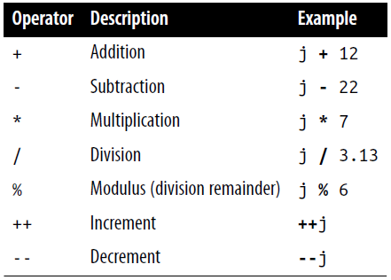
Arithmetic Operators

Slide 25
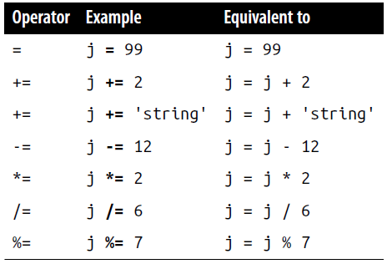
Assignment Operators

Slide 26
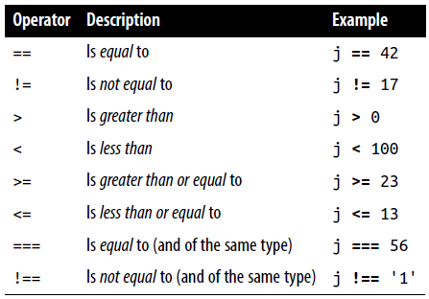
Comparison Operators

Slide 27
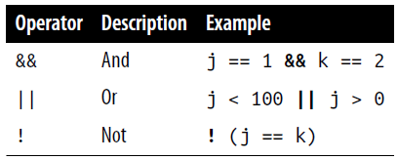
Logical Operators
Unlike PHP, JavaScript’s logical operators do not include and and or equivalents to && and ||, and there is no xor operator

Slide 28
Variable Incrementing and Decrementing
The following forms of post- and pre-incrementing and decrementing you learned to use in PHP are also supported by JavaScript:
++x
--y
x += 22
y -= 3

Slide 29
String Concatenation
JavaScript handles string concatenation slightly differently from PHP. Instead of the . (period) operator, it uses the plus sign (+), like this:
document.write("You have " + messages + " messages.")
Assuming that the variable messages is set to the value 3, the output from this line of code will be as follows:
You have 3 messages.
Just as you can add a value to a numeric variable with the += operator, you can also append one string to another the same way:
name = "James"
name += " Dean"

Slide 30
Escaping Characters
Escape characters, which you’ve seen used to insert quotation marks in strings, can also insert various special characters such as tabs, newlines, and carriage returns.
Here is an example using tabs to lay out a heading; it is included here merely to illustrate escapes, because in web pages, there are better ways to do layout:
heading = "Name\tAge\tLocation"

Slide 31
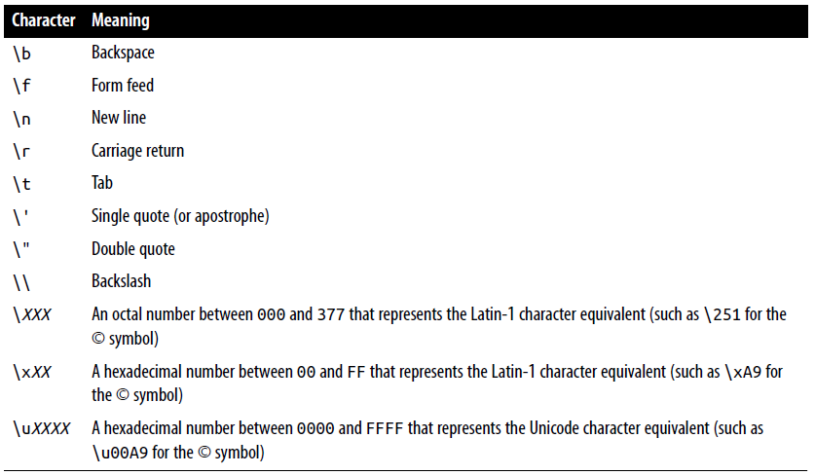

Slide 32
Variable Typing
Like PHP, JavaScript is a very loosely typed language; the type of a variable is determined only when a value is assigned and can change as the variable appears in different contexts.
Usually, you don’t have to worry about the type; JavaScript figures out what you want and just does it.
Take a look at this example where:
The variable n is assigned the string value 838102050, the next line prints out its value, and the typeof operator is used to look up the type.
n is given the value returned when the numbers 12345 and 67890 are multiplied together. This value is also 838102050, but it is a number, not a string. The type of variable is then looked up and displayed.
Some text is appended to the number n and the result is displayed.

Slide 33
<script>
n = '838102050' // Set 'n' to a string
document.write('n = ' + n + ', and is a ' + typeof n + '<br>’)
n = 12345 * 67890; // Set 'n' to a number
document.write('n = ' + n + ', and is a ' + typeof n + '<br>’)
n += ' plus some text' // Change 'n' from a number to a string
document.write('n = ' + n + ', and is a ' + typeof n + '<br>')
</script>
The output from this script looks like this:
n = 838102050, and is a string
n = 838102050, and is a number
n = 838102050 plus some text, and is a string

Slide 34
Variable Typing
If there is ever any doubt about the type of a variable, or you need to ensure that a variable has a particular type, you can force it to that type by using statements such as the following (which respectively turn a string into a number and a number into a string):
n = "123"
n *= 1 // Convert 'n' into a number
n = 123
n += "" // Convert 'n' into a string
Or, of course, you can always look up a variable’s type by using the typeof operator.

Slide 36
Functions
As with PHP, JavaScript functions are used to separate out sections of code that perform a particular task.
<script>
function product(a, b)
{
return a*b
}
</script>

Slide 37
Global Variables
Global variables are ones defined outside of any functions (or within functions, but defined without the var keyword). They can be defined in the following ways:
a = 123 // Global scope
var b = 456 // Global scope
if (a == 123) var c = 789 // Global scope
Regardless of whether you are using the var keyword, as long as a variable is defined outside of a function, it is global in scope. This means that every part of a script can have access to it.

Slide 38
Local Variables
Parameters passed to a function automatically have local scope; that is, they can be referenced only from within that function. However, there is one exception.
Arrays are passed to a function by reference, so if you modify any elements in an array parameter, the elements of the original array will be modified.

Slide 39
Local Variables
To define a local variable that has scope only within the current function, and has not been passed as a parameter, use the var keyword.
<script>
function test()
{
a = 123 // Global scope
var b = 456 // Local scope
if (a == 123) var c = 789 // Local scope
}
</script>

Slide 40
Local Variables
To test whether scope setting has worked in PHP, we can use the isset function.
But in JavaScript there isn’t one, so in this example we use the typeof operator, which returns the string undefined when a variable is not defined.
<script>
test()
if (typeof a != 'undefined') document.write('a = "' + a + '"<br>’)
if (typeof b != 'undefined') document.write('b = "' + b + '"<br>’)
if (typeof c != 'undefined') document.write('c = "' + c + '"<br>’)
function test() {
a = 123
var b = 456
if (a == 123) var c = 789
}
</script>
This shows that only the variable a was given global scope, which is exactly what we would expect, since the variables b and c were given local scope by being prefaced with the var keyword.
The output from this script is the following single line: a = "123“
Notes:
If your browser issues a warning about b being undefined, the warning is correct but can be ignored

Slide 41
The Document Object Model
JavaScript is build around the Document Object Model, or DOM.
This breaks down the parts of an HTML document into discrete objects, each with its own properties and methods and each subject to JavaScript’s control.
JavaScript separates objects, properties, and methods by using a period.
For example, let’s consider a business card as an object we’ll call card.
card.name
card.phone
card.address
For instance, to invoke a method that displays the properties of object card, you might use syntax such as this: card.display()

Slide 42
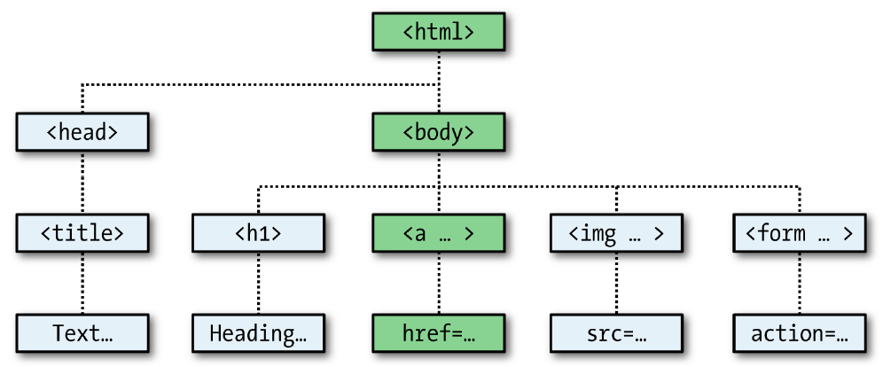
The Document Object Model
Within JavaScript, there is a hierarchy of parent and child objects, which is what is known as the Document Object Model

Slide 43
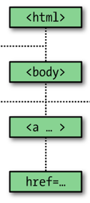
The Document Object Model
The figure uses HTML tags that you are already familiar with to illustrate the parent/child relationship between the various objects in a document.
For example, a URL within a link is part of the body of an HTML document. In JavaScript, it is referenced like this:
url = document.links.linkname.href
document refers to the <html> and <body> tags
links.linkname to the <a> tag
href to the href attribute

Slide 44
The Document Object Model
<html>
<head>
<title>Link Test</title>
</head>
<body>
<a id="mylink" href="http://mysite.com">Click me</a><br>
<script>
url = document.links.mylink.href
document.write('The URL is ' + url)
</script>
</body>
</html>
The output from this example is as follows:
Click me
The URL is http://mysite.com

Slide 45
The Document Object Model
The second line of output comes from the document.write method.
Notice how the code follows the document tree down from document to links to mylink (the id given to the link) to href (the URL destination value).
There is also a short form that works equally well, which starts with the value in the id attribute: mylink.href
So you can replace this:
url = document.links.mylink.href
with the following:
url = mylink.href

Slide 46
But It’s Not That Simple
If you tried the example in Safari, Firefox, Opera, or Chrome, it will have worked just great.
But in Internet Explorer it will fail, because Microsoft’s implementation of JavaScript, called JScript, has many subtle differences from the recognized standards.
Welcome to the world of advanced web development!

Slide 47
But It’s Not That Simple
So what can we do about this?
Well, in this case, instead of using the links child object of the parent document object, which Internet Explorer balks at, you have to replace it with a method to fetch the element by its id. Therefore, the following line:
url = document.links.mylink.href
can be replaced with this one:
url = document.getElementById('mylink').href
And now the script will work in all major browsers.

Slide 48
But It’s Not That Simple
Incidentally, when you don’t have to look up the element by id, the short form that follows will still work in Internet Explorer, as well as the other browsers:
url = mylink.href

Slide 49
Another use for the $ symbol
As mentioned, the $ symbol is allowed in JavaScript variable and function names. Because of this, you may sometimes encounter strange-looking code like this:
url = $('mylink').href
Some enterprising programmers have decided that the getElementById function is so prevalent in JavaScript that they have written a function to replace it called $, as with jQuery (although it uses the $ for much more than that)
<script>
function $(id) {
return document.getElementById(id)
}
</script>
Therefore, as long as you have included the $ function in your code, syntax such as this: $('mylink').href
can replace code such as this: document.getElementById('mylink').href

Slide 50
Using the DOM
The links object is actually an array of URLs, so the mylink URL seen before can also be safely referred to on all browsers in the following way (because it’s the first, and only, link):
url = document.links[0].href
If you want to know how many links there are in an entire document, you can query the length property of the links object like this:
numlinks = document.links.length
You can therefore extract and display all links in a document like this:
for (j=0 ; j < document.links.length ; ++j)
document.write(document.links[j].href + '<br>’)
The length of something is a property of every array, and many objects as well.

Slide 51
Using the DOM
The browser’s web history is in history
However, to stop websites from snooping on your browsing history, the history object stores only the number of sites in the array:
you cannot read from or write to these values
But you can replace the current page with one from the history, if you know what position it has within the history.
For example, to send the browser back three pages, issue the following command:
history.go(-3)
Notes:
This can be very useful in cases in which you know that certain pages in the history came from your site, or you simply wish to send the browser back one or more pages, which you do with the go method of the history object.

Slide 52
Using the DOM
You can also use the following methods to move back or forward a page at a time:
history.back()
history.forward()
In a similar manner, you can replace the currently loaded URL with one of your choosing, like this:
document.location.href = 'http://google.com’
Of course, there’s a whole lot more to the DOM than reading and modifying links.

Slide 53
About document.write
When programming, it’s necessary to have a quick and easy way to display the results of expressions. In PHP there are the echo and print statements. In JavaScript, though, there are the following alternatives:
Using console.log
The console.log function will output the result of any value or expression passed to it in the console of the current browser.
This is a special mode with a frame or window separate to the browser window, and in which errors and other messages can be made to display.
But remember that it works differently in all browsers, and the output is not near the web content in the browser.

Slide 54
About document.write
Using alert
The alert function displays values or expressions passed to it in a pop-up window, which requires you to click a button to close.
Clearly this can become quite irritating very quickly, and it has the downside of displaying only the current message—previous ones are erased.
Writing into Elements
It is possible to write directly into the text of an HTML element, which is a fairly elegant solution (and the best one for production websites)
But, it requires to create such element, and some lines of JavaScript code to access it.

Slide 55
About document.write
Using document.write
The document.write function writes a value or expression at the current browser location, and is therefore the perfect choice for quickly displaying results
You may, however, have heard that this function is regarded as unsafe by some developers, because when you call it after a web page is fully loaded, it will overwrite the current document
Notes:
I don’t use it, but almost always use the option of writing directly into a specially prepared element

Slide 56
Expressions
<script>
document.write("a: " + (42 > 3) + "<br>")
document.write("b: " + (91 < 4) + "<br>")
document.write("c: " + (8 == 2) + "<br>")
document.write("d: " + (4 < 17) + "<br>")
</script>
The output from this code is as follows:
a: true
b: false
c: false
d: true

Slide 57
Expressions
Unlike PHP (which would print the number 1 and nothing, respectively), actual strings of true and false are displayed.
In JavaScript, when you are checking whether a value is true or false, all values evaluate to true except the following, which evaluate to false: the string false itself, 0, –0, the empty string, null, undefined, and NaN (Not a Number).
Note how I am referring to true and false in lowercase. This is because, unlike in PHP, these values must be in lowercase in JavaScript.
The output from this code is as follows:
a: true
b: false
c: false
d: true

Slide 58
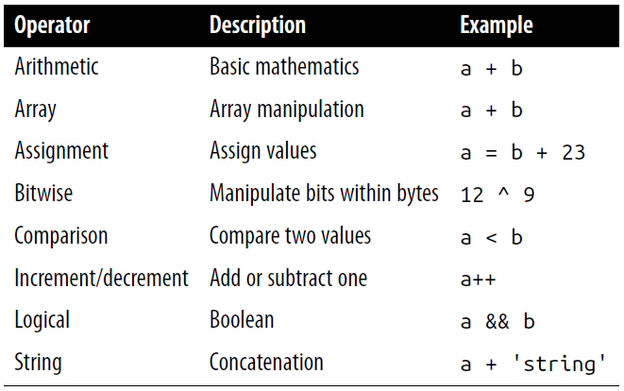
Operators

Slide 59
Logical operators
<script>
a = 1; b = 0
document.write((a && b) + "<br>")
document.write((a || b) + "<br>")
document.write(( !b ) + "<br>")
</script>
One simple note: The && and || operators are short-circuit operators.

Slide 60
The with Statement
The with is exclusive to JavaScript. With it (if you see what I mean), you can simplify some types of JavaScript statements by reducing many references to an object to just one reference.
<script>
string = "The quick brown fox jumps over the lazy dog"
with (string) {
document.write("The string is " + length + " characters<br>")
document.write("In upper case it's: " + toUpperCase())
}
</script>
Even though string is never directly referenced by document.write, this code still manages to output the following:
The string is 43 characters
In upper case it's: THE QUICK BROWN FOX JUMPS OVER THE LAZY DOG
Notes:
References to properties and methods within the with block are assumed to apply to that object.

Slide 61
The with Statement
The with is exclusive to JavaScript. With it (if you see what I mean), you can simplify some types of JavaScript statements by reducing many references to an object to just one reference.
<script>
string = "The quick brown fox jumps over the lazy dog"
with (string) {
document.write("The string is " + length + " characters<br>")
document.write("In upper case it's: " + toUpperCase())
}
</script>
This is how the code works: the JavaScript interpreter recognizes that the length property and toUpperCase() method have to be applied to some object. Because they stand alone, the interpreter assumes they apply to the string object that you specified in the with statement.

Slide 62
Using onerror
Events are actions that can be detected by JavaScript.
Every element on a web page has certain events that can trigger JavaScript functions.
For example, the onclick event of a button element can be set to call a function and make it run whenever a user clicks the button.
<script>
onerror = errorHandler
document.writ("Welcome to this website") // Deliberate error
function errorHandler(message, url, line) {
out = "Sorry, an error was encountered.\n\n";
out += "Error: " + message + "\n";
out += "URL: " + url + "\n";
out += "Line: " + line + "\n\n";
out += "Click OK to continue.\n\n";
alert(out);
return true;
}
</script>
The first line of this script tells the error event to use the new errorHandler function from now onward

Slide 63
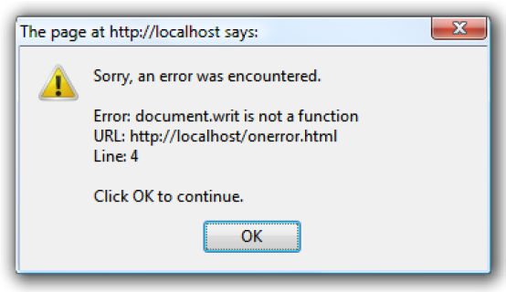
Using onerror
The figure shows the result of running this script in a browser.
Using onerror this way can also be quite useful during the debugging process.

Slide 64
Using try...catch
The try and catch keywords are more standard and more flexible than the onerror technique shown in the previous section.
These keywords let you trap errors for a selected section of code, rather than all scripts in a document.
However, they do not catch syntax errors, for which you need onerror
The try...catch construct is supported by all major browsers and is handy when you want to catch a certain condition that you are aware could occur in a specific part of your code.

Slide 65
Using try...catch
<script>
try {
request = new XMLHTTPRequest() // Ajax object that doesn’t work in IE
}
catch(err) {
// Use a different method to create an XML HTTP Request object
}
</script>
There’s also another keyword associated with try and catch called finally that is always executed, regardless of whether an error occurs in the try clause. To use it, just add something like the following statements after a catch statement:
finally
{
alert("The 'try' clause was encountered")
}

Slide 66
If statement
Unlike PHP, JavaScript has no elseif statement, but that’s not a problem, because you can use an else followed by another if to form the equivalent of an elseif statement, like this:
if (a > 100)
document.write("a is greater than 100")
else if(a < 100)
document.write("a is less than 100")
else
document.write("a is equal to 100")

Slide 67
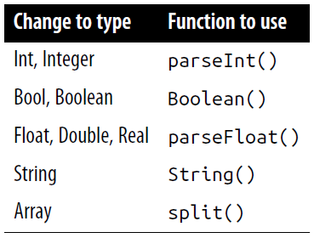
Explicit Casting
Unlike PHP, JavaScript has no explicit casting of types such as (int) or (float).
Instead, when you need a value to be of a certain type, use one of JavaScript’s built-in functions

